Slide 1
Linear Lists
Materials are adapted from “Data Structures: A Pseudocode Approach with C,” 2nd ed., by Richard F. Gilberg & Behrouz A. Forouzan

Slide 2
Linear Lists
A linear list is a list in which each element has a unique successor
Linear lists
Restricted lists
General lists
Restricted lists
Addition and deletion of data are restricted to the ends of the list
LIFO(last in-first out) list (stack)
FIFO(first in-first out) list (queue)
General lists
Data can be inserted or deleted anywhere in the list

Slide 3
General Linear Lists

Slide 4
General linear list
A general linear list
A list in which operations, such as retrievals, insertions, changes, and deletions, can be done anywhere in the list
At the beginning , in the middle, or at the end of the list
Basic operations
Insertion
Deletion
Retrieval
Traversal

Slide 5
Insertion
List insertion can be ordered or random
Random list (or chronological lists)
there is no sequential relationship between two elements
Generally data inserted at the end of the list
Data-gathering applications use random lists
Ordered lists
are maintained in sequence according to the data or a key that identifies the data
A key is one or more fields within a structure that identifies the data Ex) social security number
Data must be inserted into ordered lists so that the ordering of the list is maintained

Slide 6
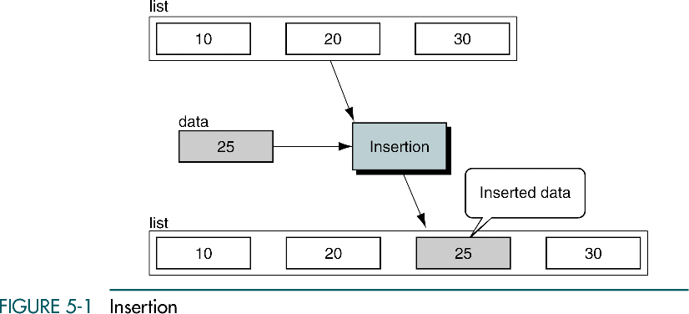
Insertion
Inserting the data in ordered lists
At the beginning or at the end of the list, but most of the time data are inserted (somewhere) in the middle of the list
To determine where the data are to be placed, a search algorithm is required

Slide 7
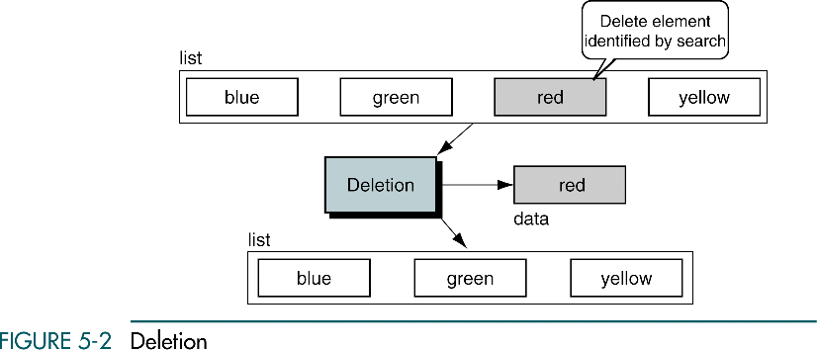
Deletion
Deletion requires the list be searched to locate data being deleted

Slide 8
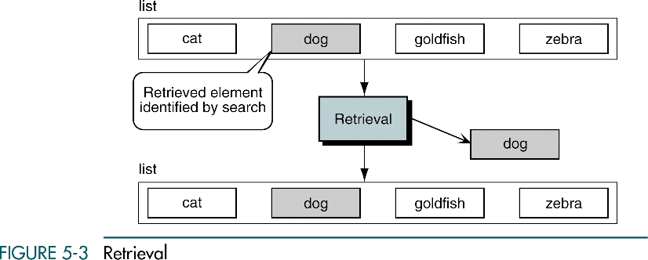
Retrieval
Requires data to be searched and located in a list and presented to the calling module without the change in contents of the list.
As with both insertion and deletion, a search algorithm can be used to locate the data to be retrieved from a list

Slide 9
Traversal
List traversal processes each element in a list in sequence
Looping algorithm used and each execution of the loop processes one element in the list
Loop terminates when all elements have been processed

Slide 10
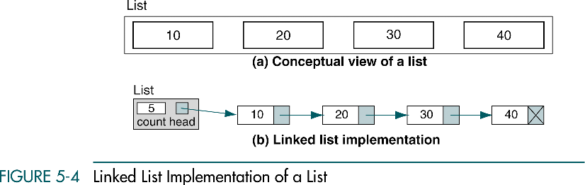
Implementation
Linked list is a good structure for a list because data are easily inserted and deleted at the beginning, in the middle, or at the end of the list

Slide 11
Data structure
Head node
Head node structure stores the head pointer and other data about the list. (known as metadata; data about the data)
Ex) metadata: count (the number of nodes currently in the list)
Data node
The data type depends entirely on the application
Data node includes data fields
One of the data fields can be a key field for applications that require searching by key
data
key
field1
field2
…
fieldN
end data

Slide 12
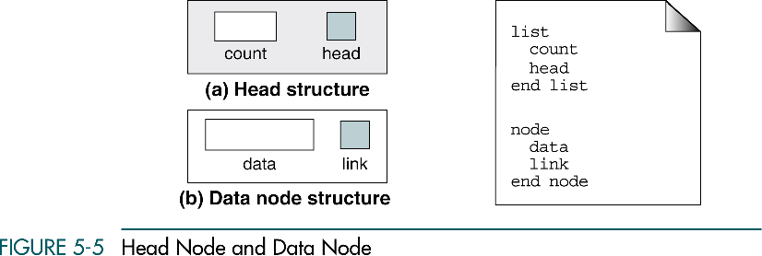
Data structure

Slide 13

Create List
Create list allocates the head structure and initializes the metadata for the list

Slide 14
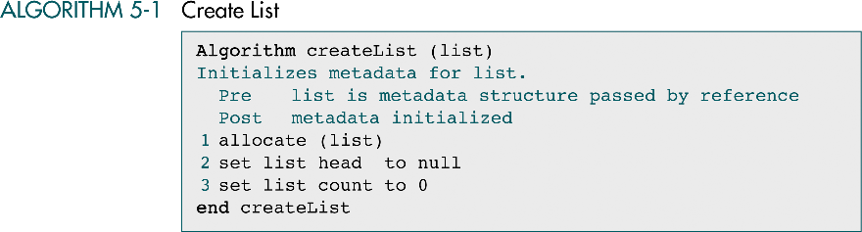
Create List

Slide 15
Insert Node
Insert node
adds data to a list
We need only its logical predecessor to insert a node into the list
Three steps:
Allocate memory for the new node and move data to the node
Point the new node to its successor
Point the new node’s predecessor to the new node
These steps appear to be simple, but …

Slide 16
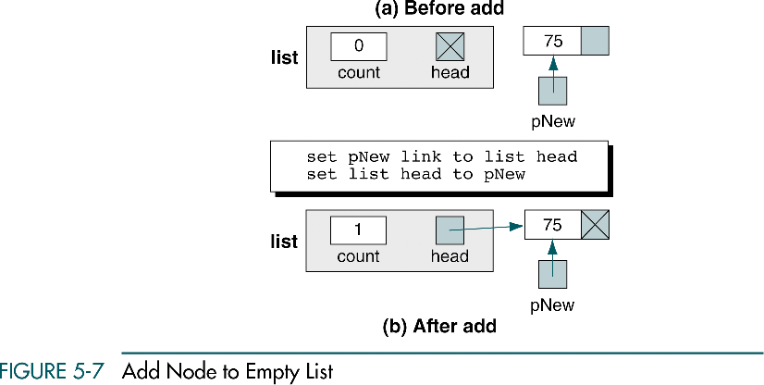
Insert Node
Insert into Empty List
When the head pointer of the list is null, the list is empty.
To add a new node, the list header pointer should be assigned the address of the allocated node and make sure that its link field is a null pointer.

Slide 17
Insert Node
Insert at Beginning
A new node is added before the first node of the list.
Determine that addition is at the beginning of the list by testing the predecessor pointer
If the predecessor pointer is a null pointer, there is no predecessor, so we are at the beginning of the list.
Point the new node to the first node of the list and then set the head pointer to point to the new first node.
Logically inserting into an empty list is same as inserting a the beginning.

Slide 18
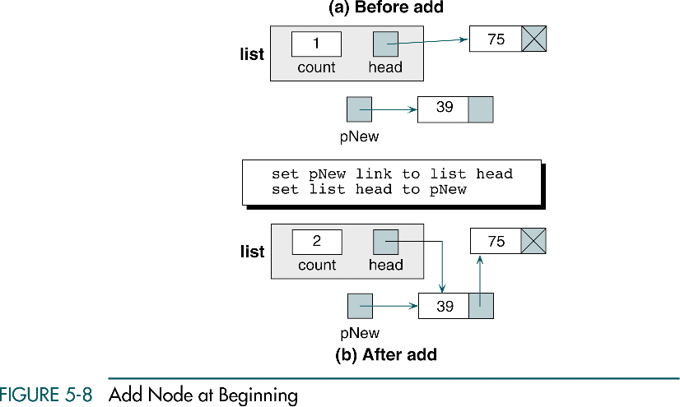
Insert Node
Insert at Beginning

Slide 19
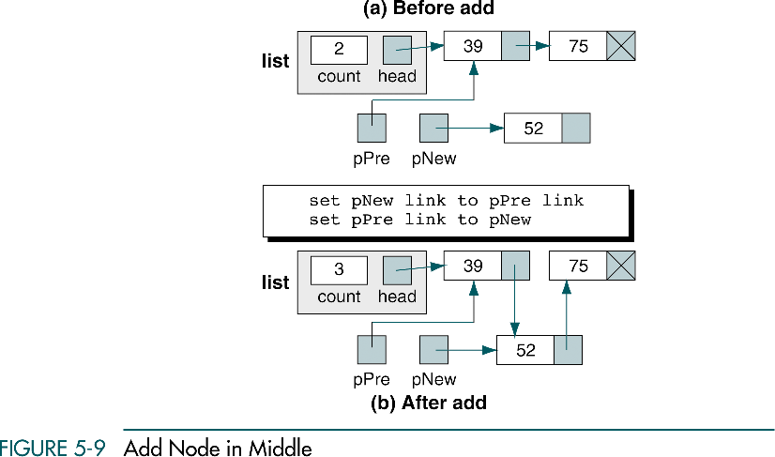
Insert Node
Insert in Middle
When we add a node anywhere in the middle of the list, the predecessor pointer contains an address
Point the new node to its successor and then point its predecessor to the new node. The address of the new node’s successor can be found in the predecessor’s link field.

Slide 20
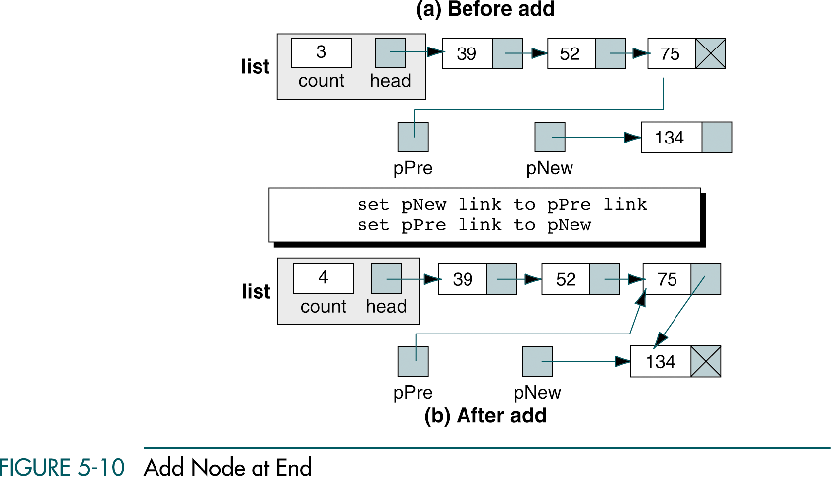
Insert Node
Insert at End
When adding at the end of the list, we only need to point the predecessor to the new node. There is no successor
The new node’s link field should be set to null pointer. Also, the last node in the list has a null pointer. If we use this pointer rather than a null pointer constant, the code becomes same as the inserting in the middle.

Slide 21
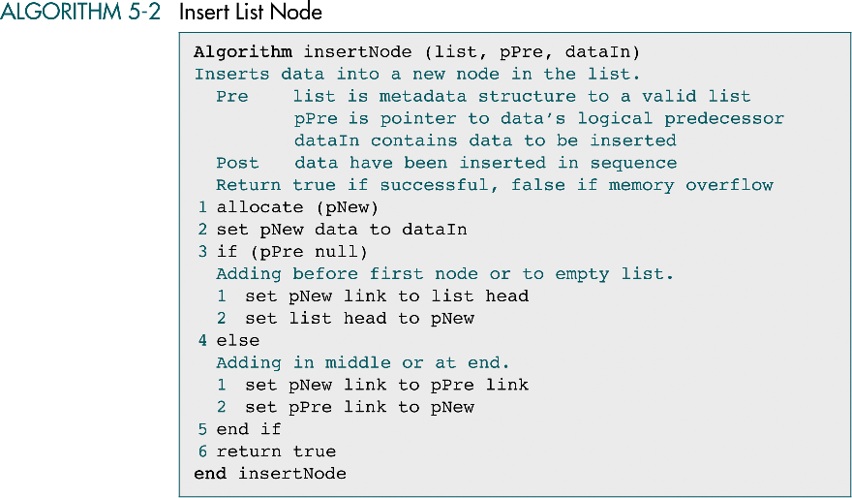
Insert Node Algorithm

Slide 22
Delete Node
Delete Node algorithm
Logically removes a node from the list by changing pointers and then physically deleting the node from dynamic memory.
Locate the node to be deleted by knowing its address and its predecessor’s address.
Change the predecessor’s link field to point to the deleted node’s successor
We then recycle the node back to dynamic memory.
If deleting the only node in the list, results in empty list and set the head to a null pointer
The delete situations
The only node, the first node, a node in the middle, or the last node of the list

Slide 23
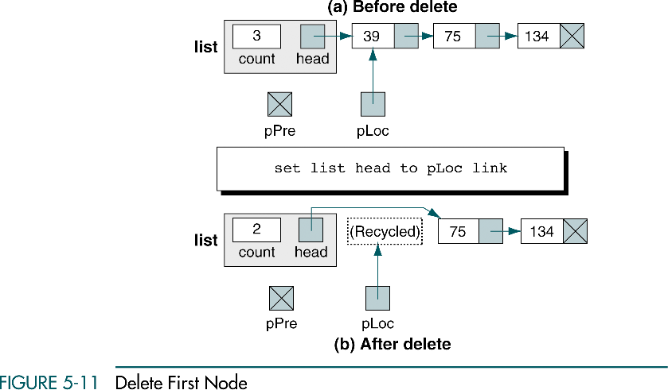
Delete Node
Delete First Node
When deleting first node, the head pointer must be reset to point to the node’s successor and then recycle the memory for the deleted node

Slide 24
Delete Node
General Delete Case
Deleting in the middle or at the end is a general case
Simply point the predecessor node to the successor of the node being deleted.
When the node being deleted is the last node of the list, its null pointer is moved to the predecessor’s link field, making the predecessor the new logical end of the list

Slide 25
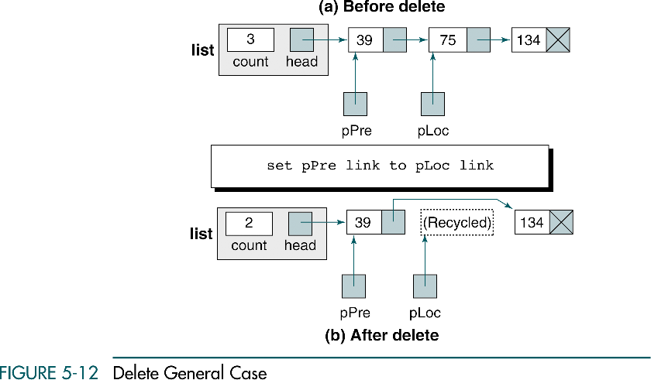
Delete Node
General Delete Case

Slide 26
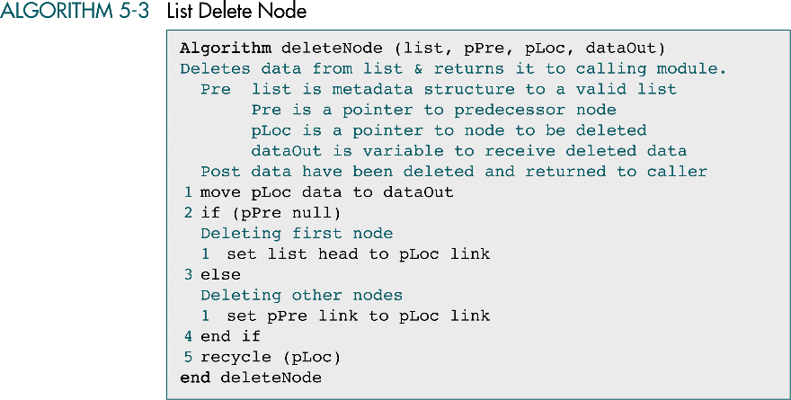
Delete Node Algorithm
We may copy the deleted node’s data to a data out area in the calling program.

Slide 27
List Search
A list search
is used to locate data in a list
To insert data, we need to know the logical predecessor to the new data.
To delete data, we need to find the node to be deleted and identify its logical predecessor.
To retrieve data from a list, we need to search the list and find the data.
We must use a sequential search because there is no physical relationship among the nodes.
The classic sequential search returns the location of an element when it is found and the address of the last element when it is not found.
Because the list is ordered, we need to return the location of the element when it is found and the location where it should be placed when it is not found.

Slide 28
List Search
Given a target key, the ordered list search attempts to locate the requested node in the list.
To search a list on a key, we need a key field.
For simple lists the key and the data can be the same field.
If a node in the list matches the target value, the search returns true; if there are no key matches, it returns false.

Slide 29
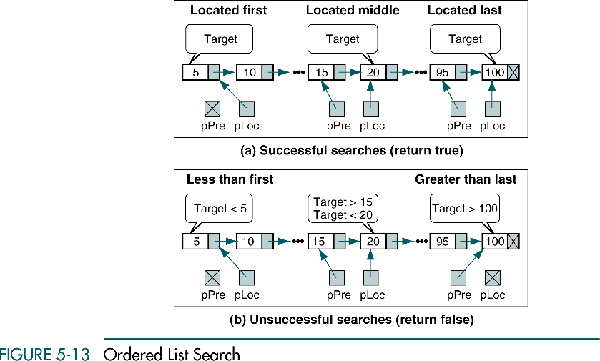
Start at the beginning of the list and search until the target value is not greater than the current node’s key.
At this point the target is either less than or equal to the current node’s key while the predecessor is pointing to the node immediately before the current nodes.
Test the current node and return true if the target value is equal to the list value or false if it is less and terminate the search.

Slide 30
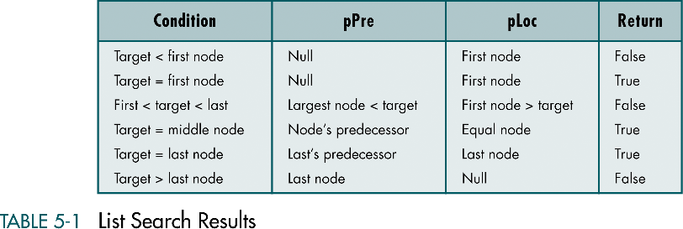
List Search

Slide 31
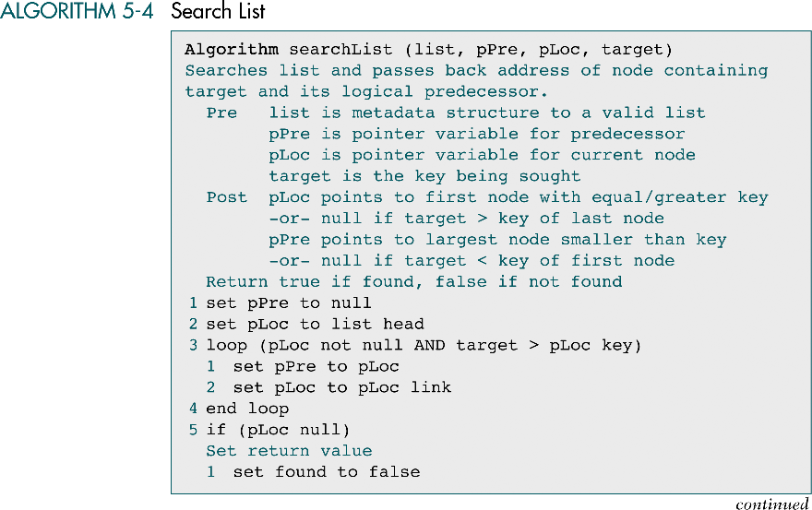
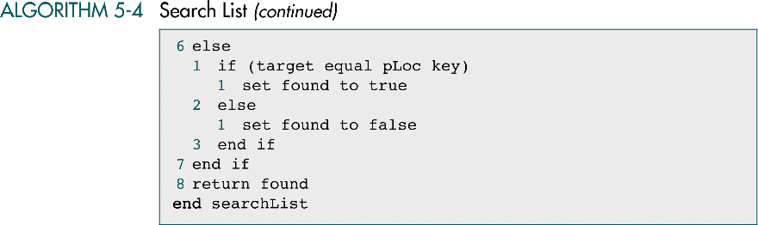

Slide 32
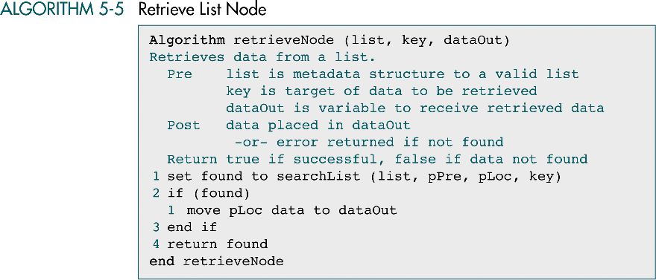
Retrieve Node
Retrieve node
uses search node to locate the data in the list
If the data are found, it moves the data to the output area in the calling module and returns true.
If data are not found, returns false

Slide 33
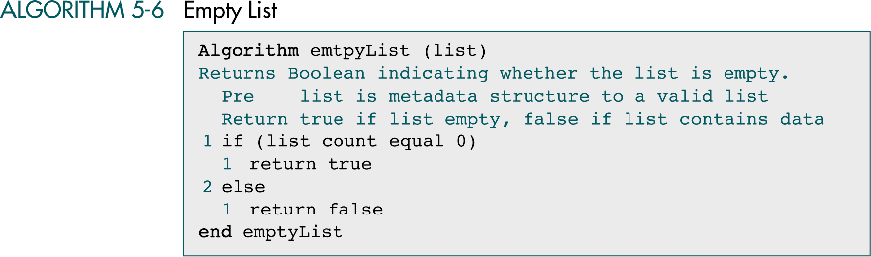
Empty List
A simple module that returns true or false indicating that there are data in the list or the list is empty.

Slide 34
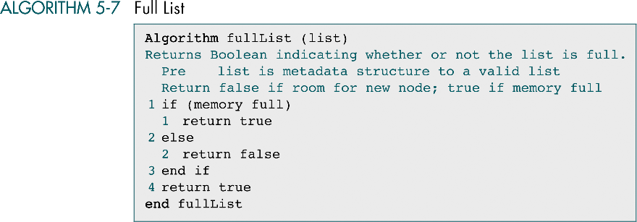
Full List
Very few languages provide how much memory is left in dynamic memory - C does not

Slide 35

List Count
List count returns the number of nodes in the current nodes
It is necessary because the calling module has no direct access to the list structure

Slide 36
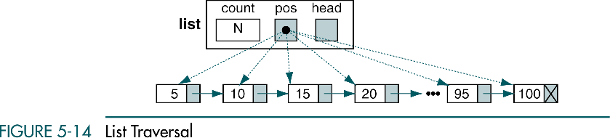
Traverse List
Traversal
starts at the first node and examines each node in the succession until the last node has been processed
Any application that requires that the entire list be processed uses a traversal
Ex) changing a value in each node, printing the list, summing a field in the list, calculating the average, etc.
We need a walking pointer (a pointer that moves from node to node as each element is processed)

Slide 37
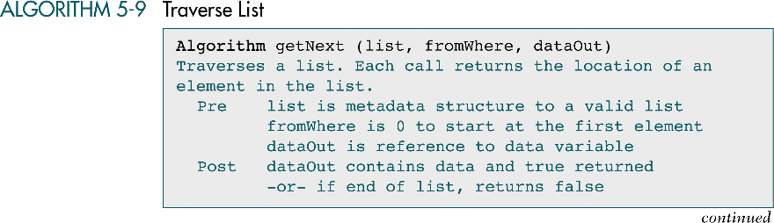
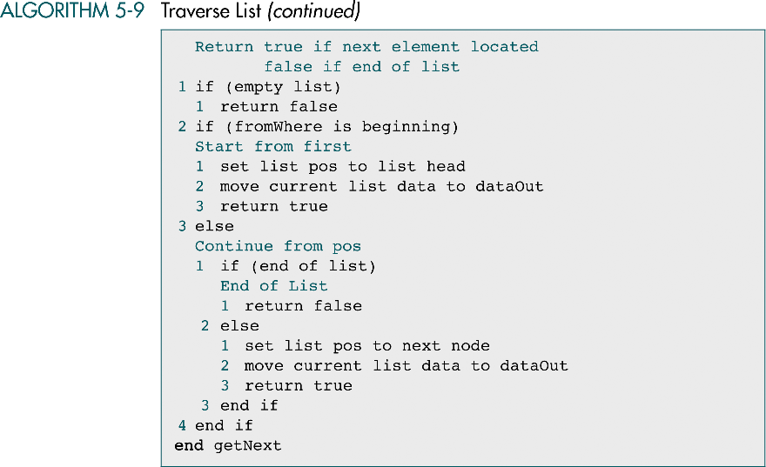

Slide 38

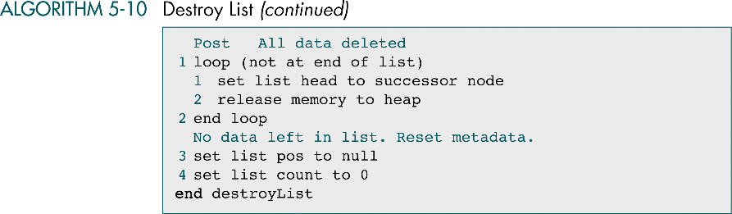
Destroy List
When the list is no longer needed and the application is not done, the list should be destroyed.
Destroy list
deletes any nodes still in the list and recycles their memory and set the metadata to a null list condition

Slide 39
Complex Implementations
Singly linked list
It contains only one link to a single successor
Three other implementations:
Circularly linked list
Doubly linked list
Multilinked list

Slide 40
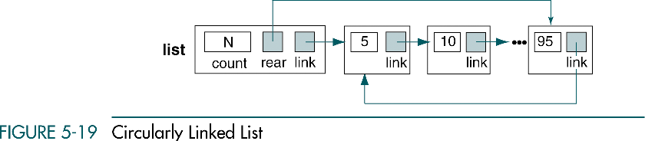
Circularly Linked Lists
Circularly linked lists
The last node’s link points to the first node of the list
are primarily used in lists that allow access to nodes in the middle of the list without starting at the beginning

Slide 41
Circularly Linked Lists
Insertion and deletion from a circularly linked list
Follow the same logic patterns used in a singly linked list
except that the last node points to the first node.
Therefore, when inserting or deleting the last node, we must point the link field to the first node
If the search target lies before the current node?
In the singly linked list, when we arrive at the end of the list the search is complete
In the circularly linked list, automatically continue the search from the beginning of the list

Slide 42
Circularly Linked Lists
If the target does not exist?
In the singly linked list, we stopped when hit the end of the list or when the target was less than the current node’s data
In the circularly linked list, we save the starting node’s address and stop when we have circled around to it
loop (target not equal to pLoc key
AND pLoc link not equal to startAddress)

Slide 43
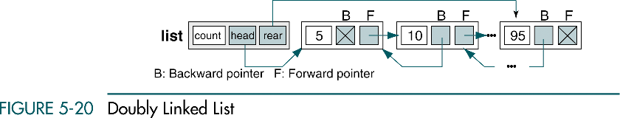
Doubly Linked Lists
A doubly linked list
is a linked list structure in which each node has a pointer to both its successor (forward pointer) and its predecessor (backward pointer)

Slide 44
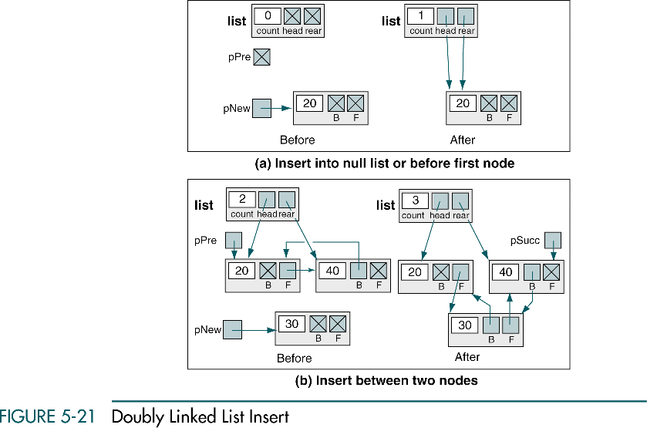

Slide 45
Doubly Linked Lists
Insertion
Follows the basic pattern of inserting a node into a singly linked list, but we also need to connect both the forward and the backward pointers
To insert a node into a null list
The head and rear pointers to point to the new node
To insert a node between two nodes
The head structure is unchanged
The new node needs to be set to point to both its predecessor and its successor,
and they need to be set to point to the new node
To insert a node at the end of the list
The forward pointer of the new node is set to null
The rear pointer in the head structure must be set to point to the new rear node

Slide 46
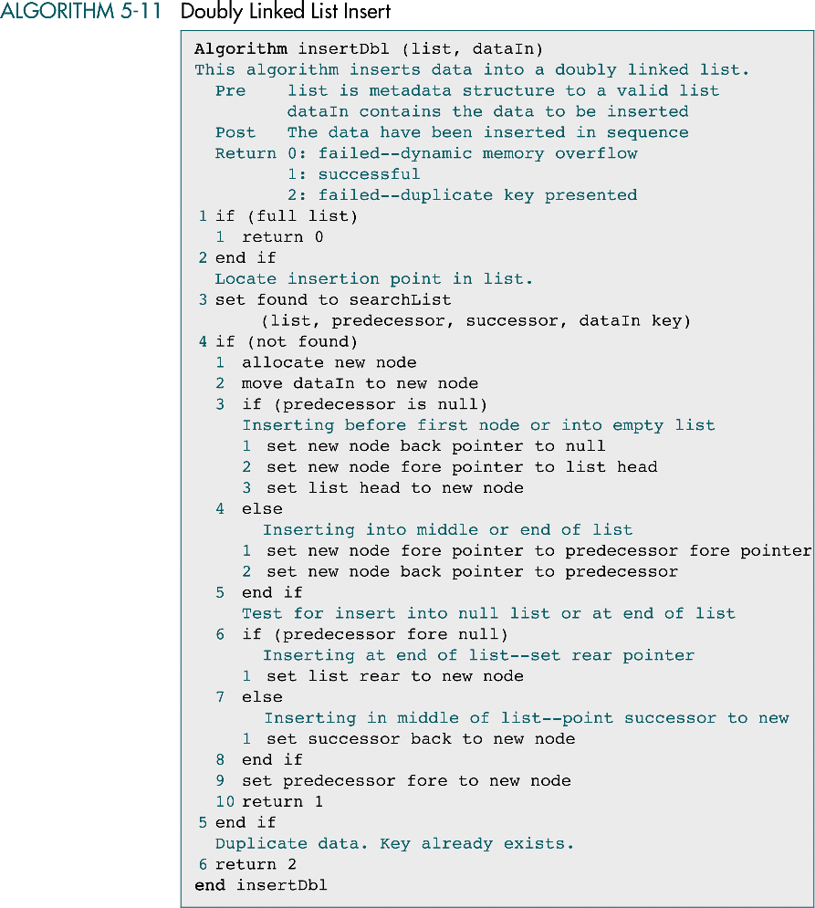

Slide 47
(continued)

Slide 48
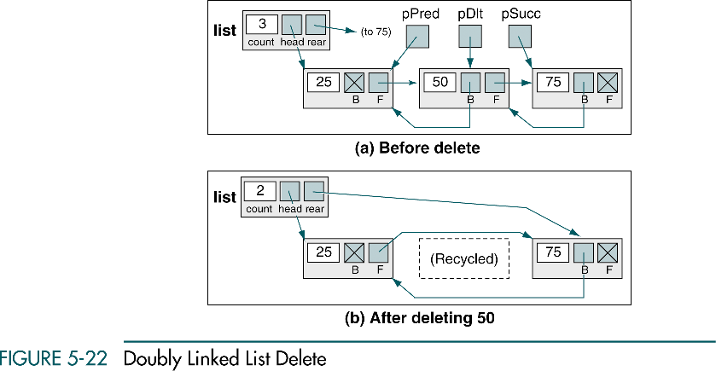
Doubly Linked Lists
Deletion

Slide 49
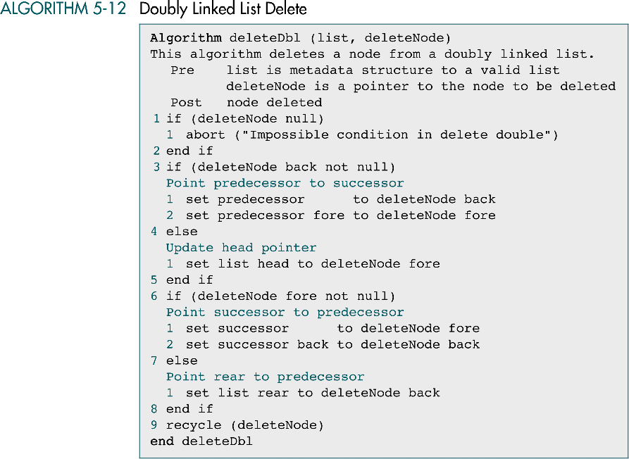

Slide 50
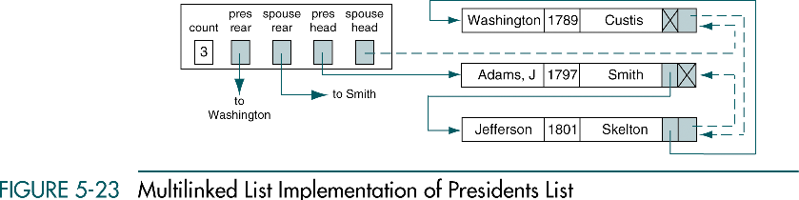
Multilinked Lists
A multilinked list
Is a list with two or more logical key sequences
The same set of data can be processed in multiple sequences

